Slide 1
HRET HIIN Hospital Collaborative LISTSERV®
Subscriber’s Tutorial

Slide 2
Instructions Include
How to set-up your account
How to post/send/reply (to) messages
How to update your settings, to batch messages
How to view archives
Where to change preferences

Slide 3
Setting Up Your Account
1. Go to:
http://ahals.aha.org/scripts/wa-AHALS.exe?LOGON
2. Click on get a new LISTSERV®
password and enter your email address
and created password. Click Register
Password.
3. A Confirmation Sent message will appear
notifying you that a verification email will
be sent to your email inbox.

Slide 4
Setting Up Your Account
4. (Sample email message received) Click on the link found in the body of the text to verify your email address. This will confirm that your new password was registered successfully.
5. Go to: http://ahals.aha.org/scripts/wa-AHALS.exe?LOGON and login with your username (email address) and password.

Slide 5
Posting/Sending Messages
6. Click on Subscriber Corner (top left side) found in top Menu toolbar (Subscriber’s Corner, Email Lists).

Slide 6
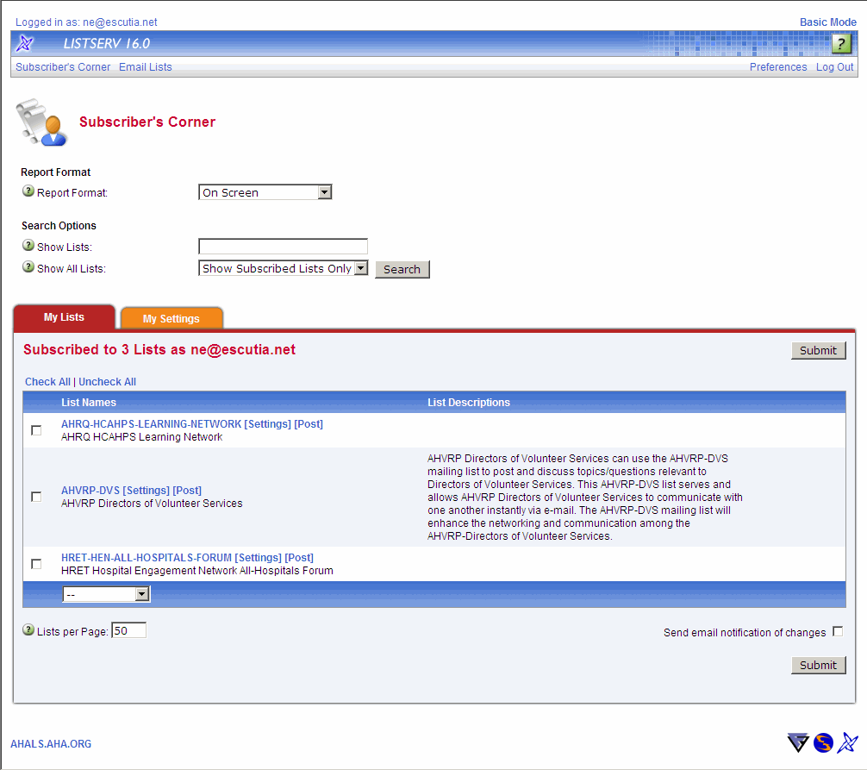
Posting/Sending Messages
7. A listing of all the LISTSERVs® you currently subscribe to will appear in the My Lists tab. Click on Post next to the list name you want to post a message to.

Slide 7
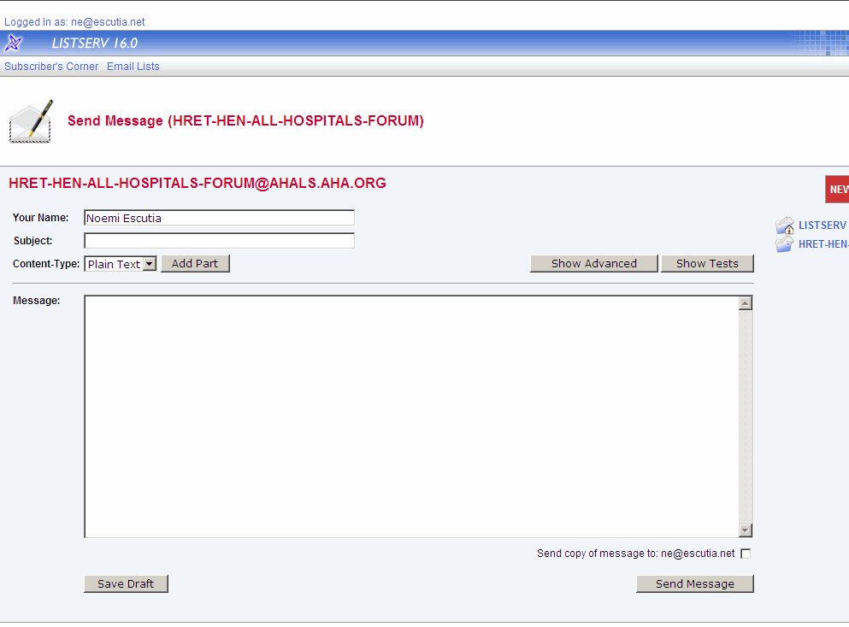
Posting/Sending Messages
8. Fill out the form and click on Send Message. *Note: in Content-Type you may choose from Plain Text or HTML.

Slide 8
Updating Settings: Batching Messages
9. Click Setting next to the list name or click on the My Settings tab.

Slide 9
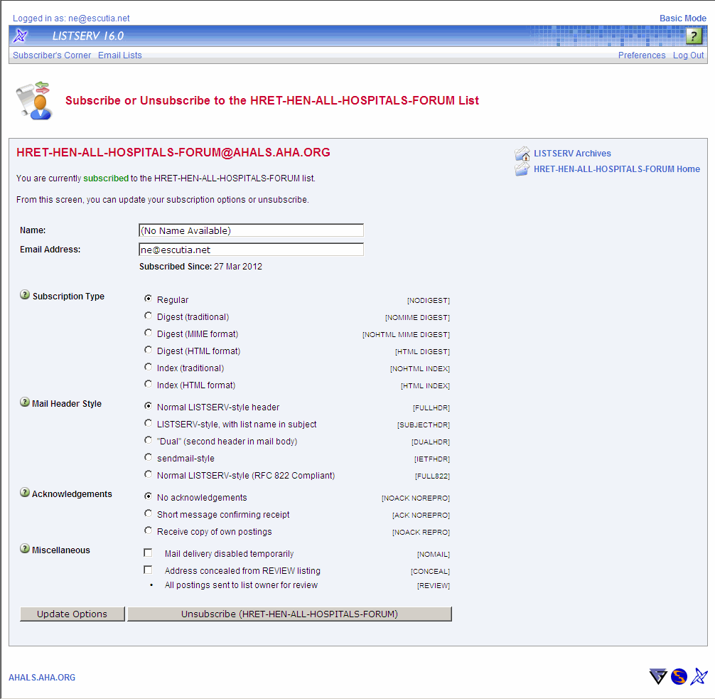
Updating Settings: Batching Messages
10. Review your profile and make any changes necessary.
Subscription Type:
Mail = receive messages as they are posted.
*** (recommended) Digest = receive one daily message with all the contributions for the day.
No Mail = receive no mail from this mailing list (often used when on extended leave or vacation, as this option still allows you to access the list archives).
Ability to:
Search LISTSERV® Archives
Return to Homepage

Slide 10
Viewing Archives
11. Click on the entire list name.

Slide 11
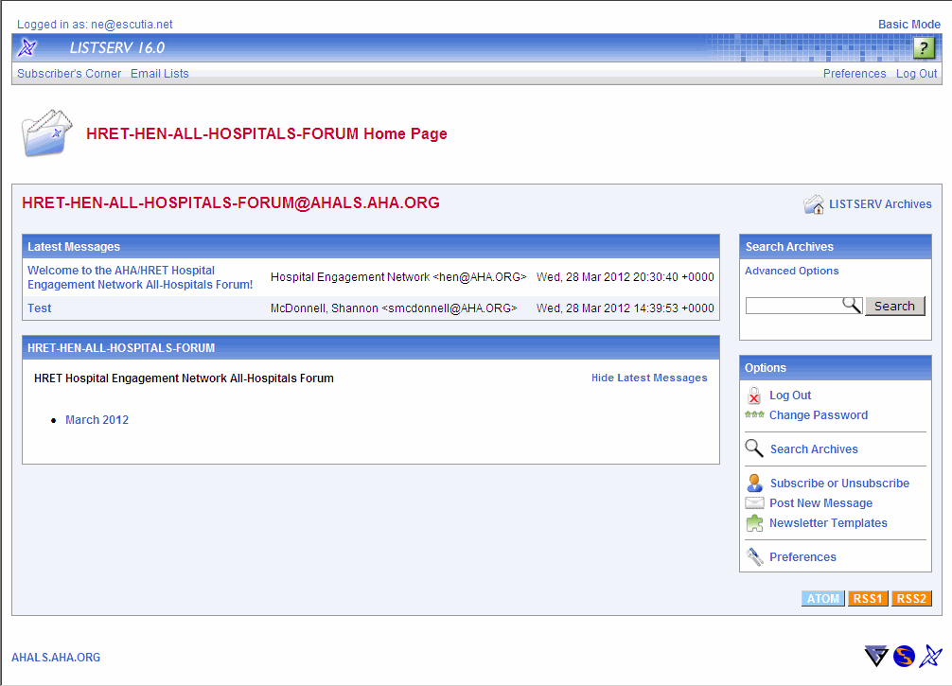
Viewing Archives
12. Click on the Month that you would like to view archives, such as March 2012.

Slide 12
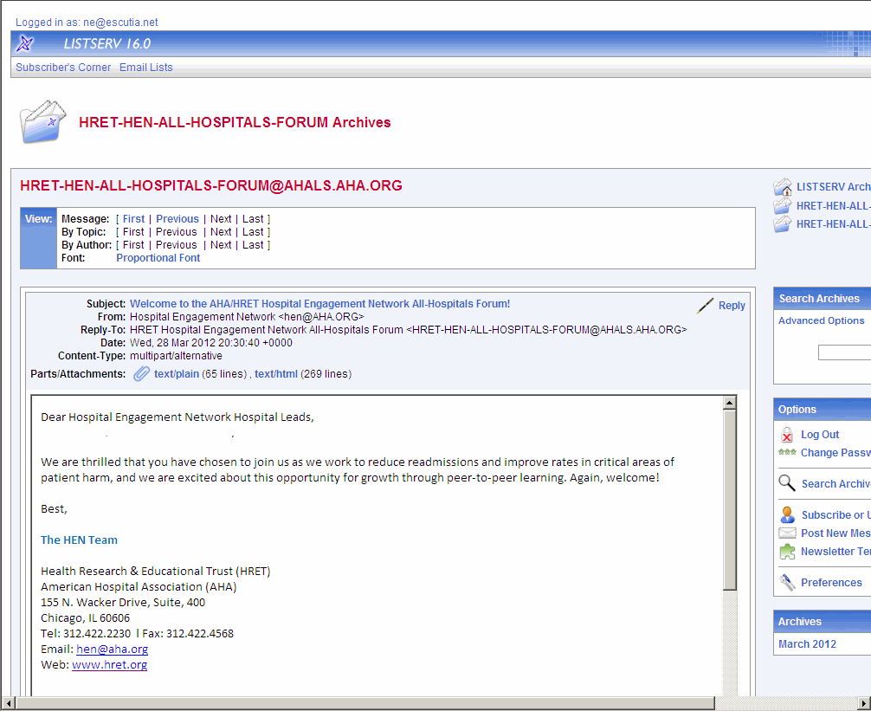
Replying to Archived Messages
13. Reply to message
by clicking on Reply.

Slide 13
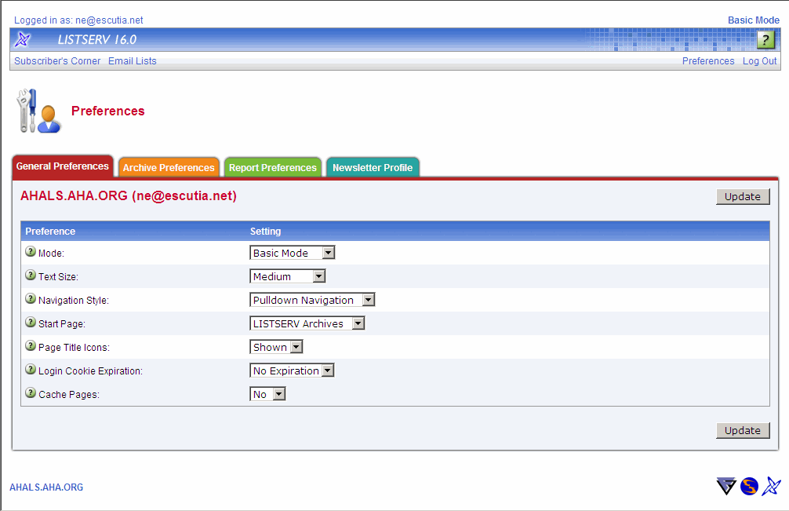
Changing Preferences
14. Click the various
Preferences tabs to
change General,
Archive and Report
preferences.

Slide 14
Questions?
If you have additional questions,
please contact us:
HIIN@aha.org

