Slide 1


Simple-Easy-Transparent-Trust
www.ppe.exchange

Slide 2
Our Mission & Origin
To utilize next generation technology to provide a transparent, efficient and trusted digital marketplace facilitating the procurement process of B2B transactions.

Slide 3
User Friendly
Practical & Convenient
+
Advanced Technologies

Slide 4






PPE. Exchange
1900+ Sign Ups
1000+ Hospitals
275+ Verified Vendors
10M+ PPE Units Supplied
GOV Contractor Listings
Daily Request For Proposal (RFP) Listings
Setting Industry Standards for PPE Verification Practices
Only Amazon like buying experience for PPE Purchasing today

Slide 5
Buyer Benefits
Completely Free To Use- No Subscription
Fraud Prevention- Setting Industry Standards for PPE Verification
Large Selection of PPE & Suppliers- Over 900 signed up, 250 verified.
RFP Functionality- Have over 250+ Vendors bid for your business
Price Transparency- Curated Listings/ Price Competition
Order Tracking- Track, view and manage the order throughout its lifecycle
Group Pricing- Aggregate PO Functionality Built in
Ease of Use- Sort and Compare PPE Listings side by side

Slide 6
Seller Opportunities
Custom Payment Terms-Vendors have the ability to set custom payment terms for each transaction
New Markets & New Customers- Connect with new buyers
Ease of Sale- List and Sell Products Effortlessly
High Quality B2B Buyers- Verified organizational need for your PPE
Digital Storefront- No need for additional websites to list your products

Slide 7
Supplier Verification- Basic Overview
PPE. Exchange is redefining PPE Verification in the US
Company Info Collection
Price Competitiveness
Legitimacy ratings
Access to trial environment
Upload Product Listings, Verification Documents, Price Point
OpenFDA, NIOSH 510k integration
Buyer review
Badge system
Sort by Listing Updated
Pre-Entry
Ask About Business
Analyze Industry Knowledge
Reference check
Onboarding Call
Trial Phase
Ongoing Moderation
Data is constantly tracked on our blockchain

Slide 8
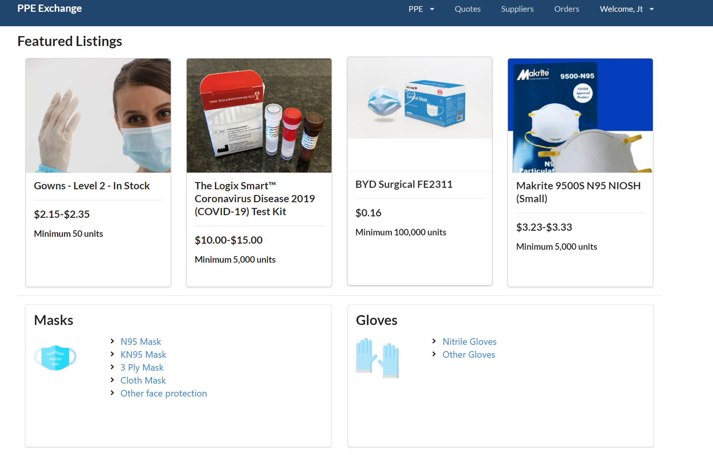
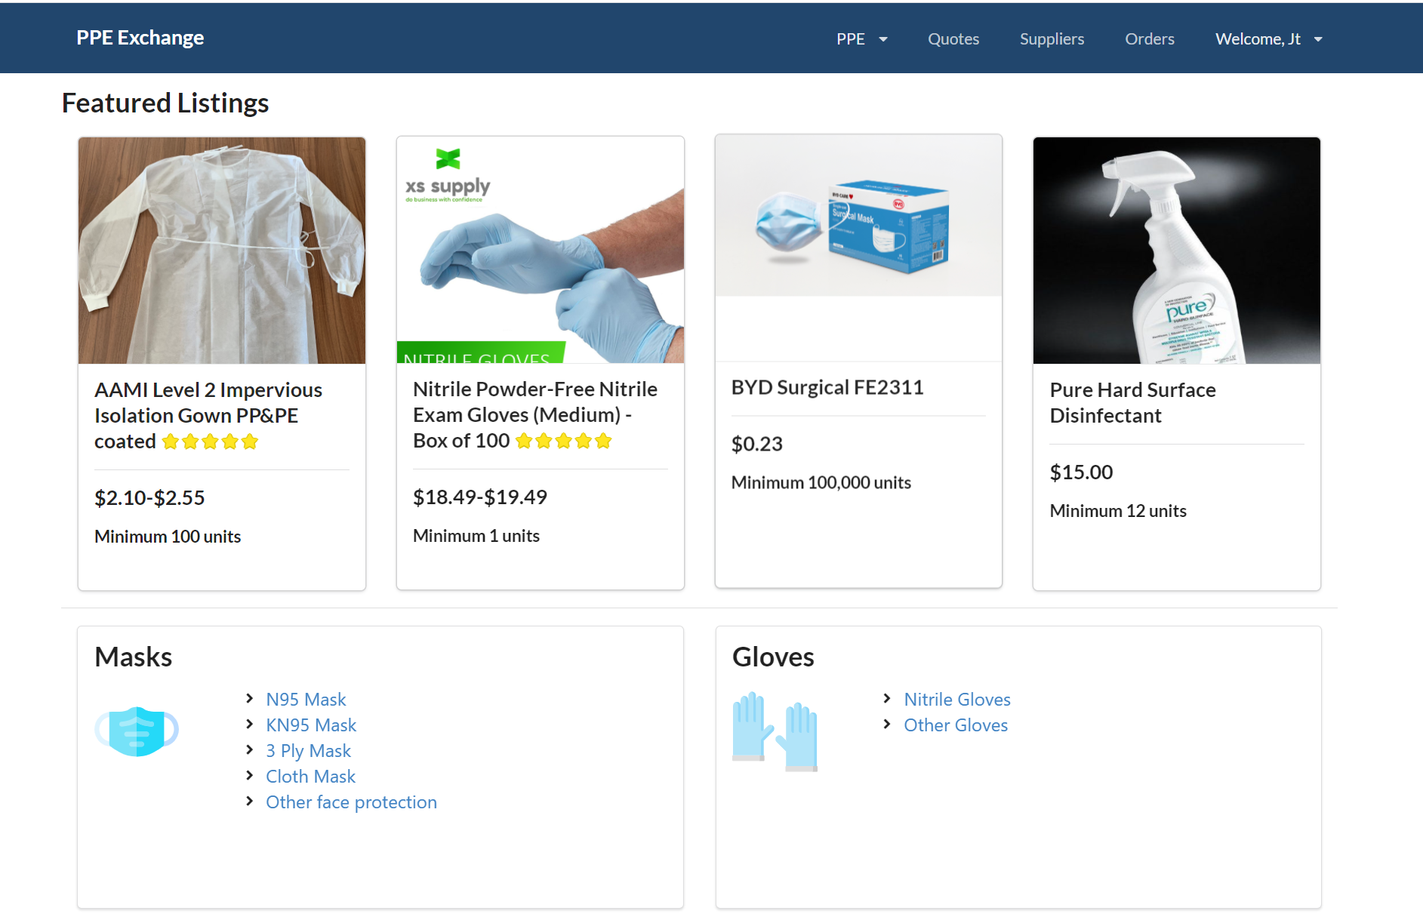
Home Page

Slide 9
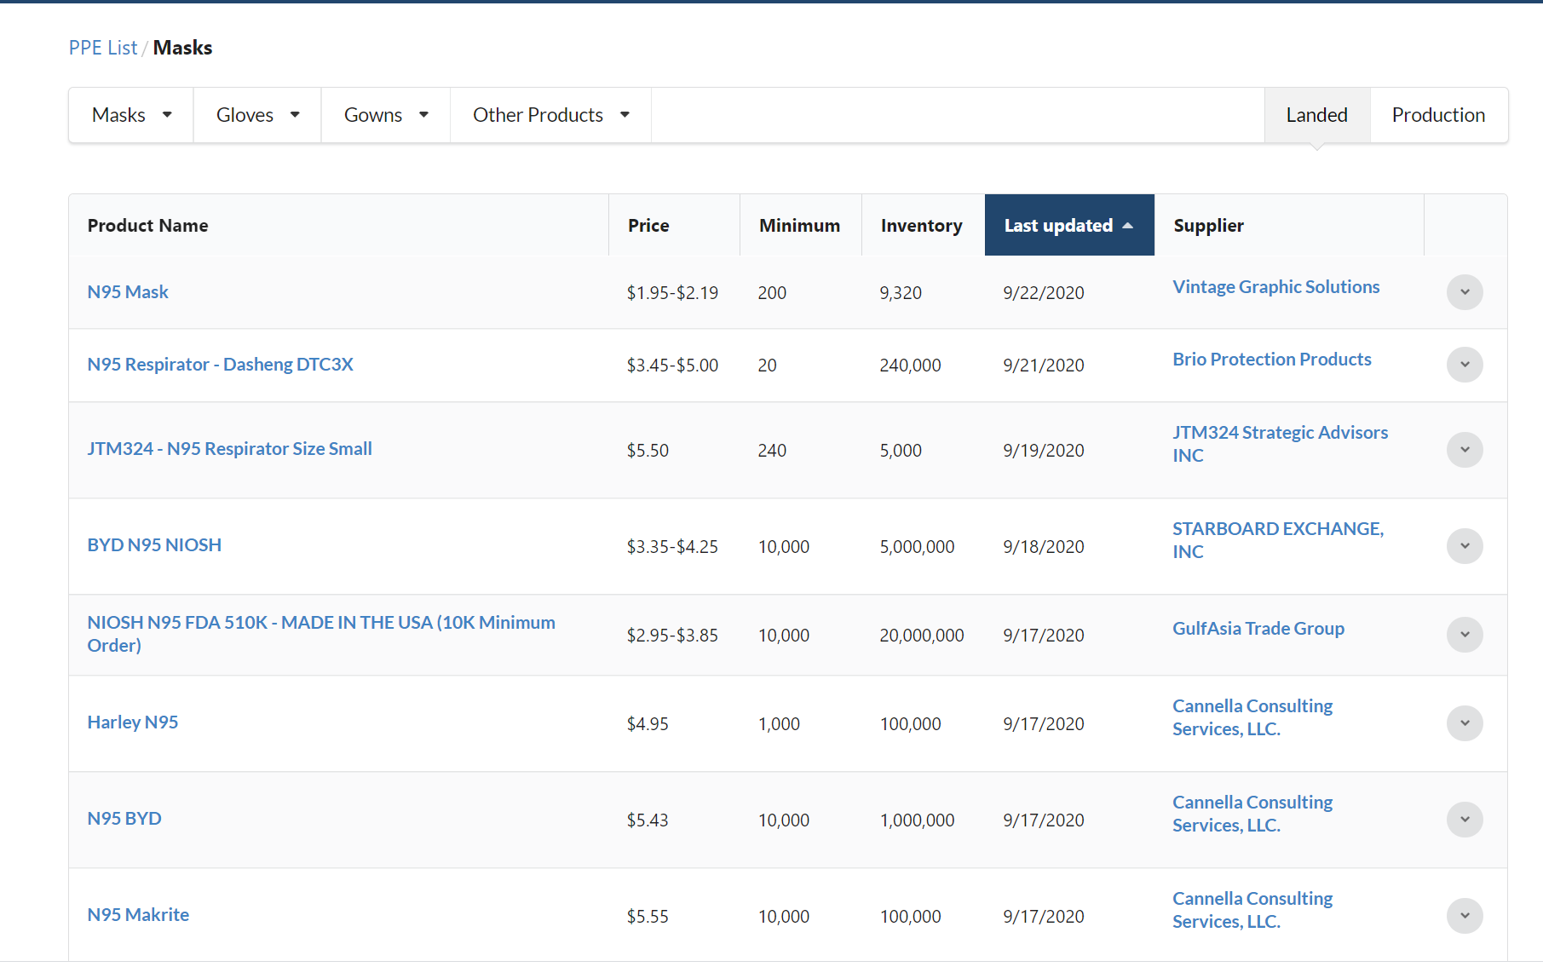
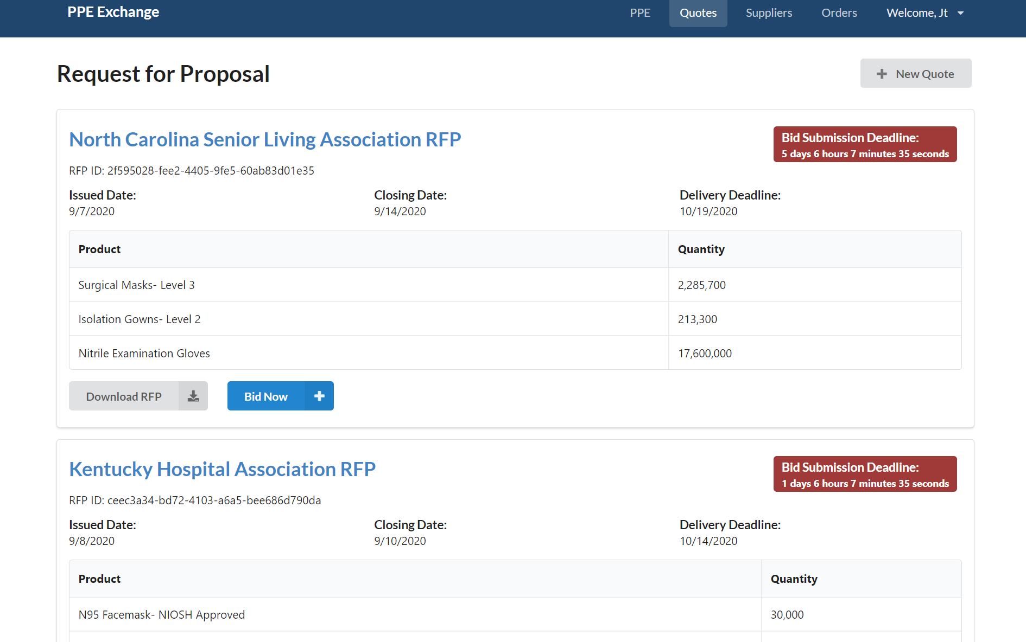
Browse Listings
RFP Request
Notes:
We have a specialized team for brokering large, complex orders with our extensive network of manufacturers.
From 5-10 verified distributors to a couple hundred

Slide 10
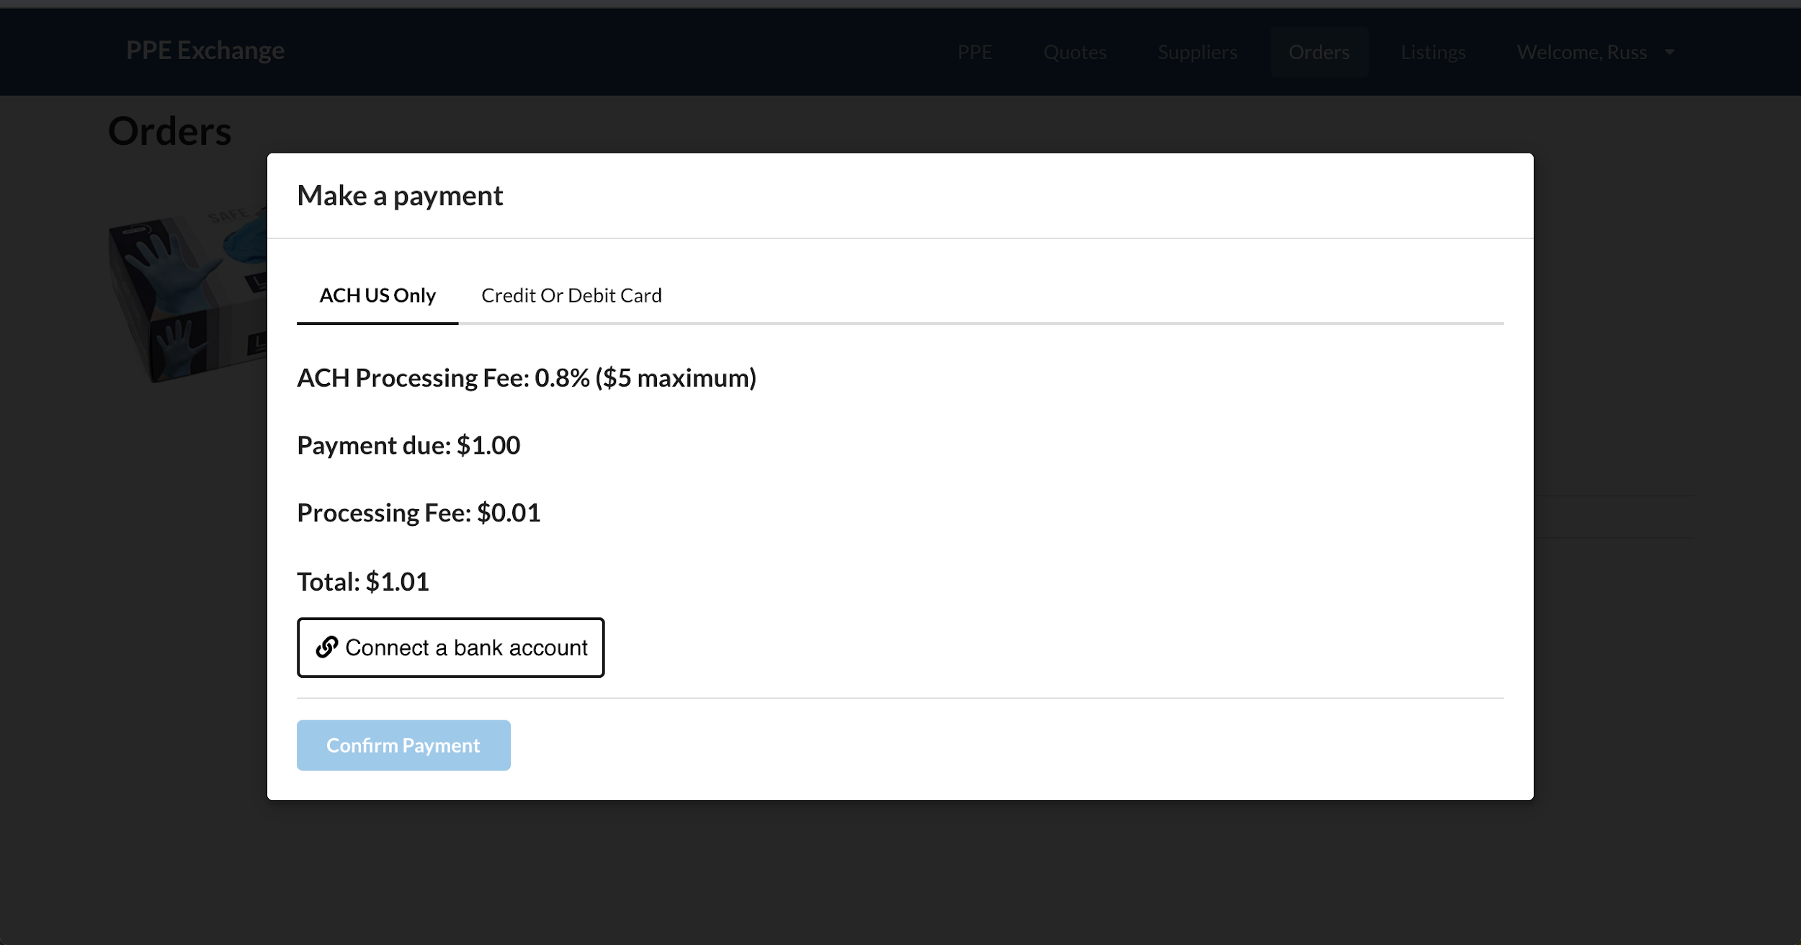

Step 4: Submit Payment
Notes:
ACH vs Credit Card Fees and security behind it

Slide 11
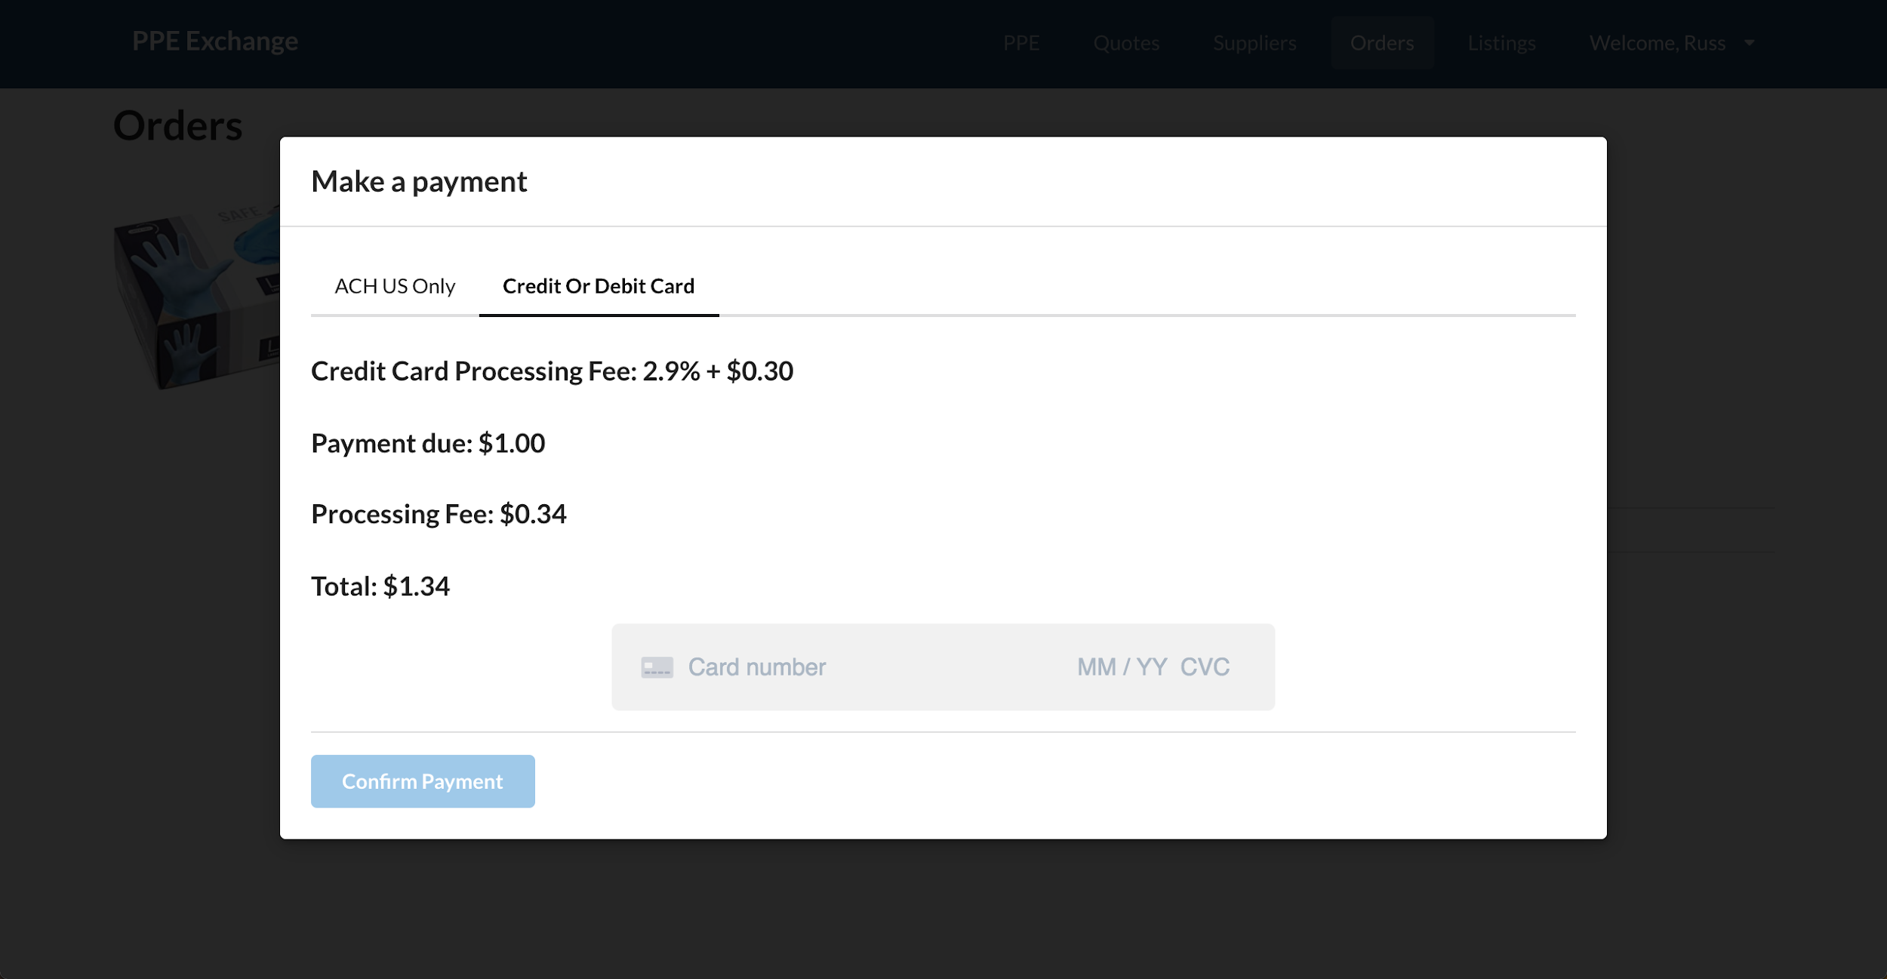

Step 4: Submit Payment
Notes:
ACH vs Credit Card Fees and security behind it

Slide 12

Step 5: Receive your shipment!
Notes:
ACH vs Credit Card Fees and security behind it

Slide 13
Next Steps
Proceed to https://ppe.exchange/
Click “Become a buyer”
Our team will verify your email
Start buying!

Slide 14
Contact
Info@ppe.exchange
jt@ppe.exchange
rich.garwood@ppe.exchange

Slide 15
How to place an order

Slide 16
FAQs
How do I track my order status?
  Click on the “Orders” Tab to view current
  For more information email info@ppe.exchange
Who do I contact with questions regarding my order?
  info@ppe.exchange
What happens if I have issues with my credit card during payment?
  Reach out to your bank/credit card company
Does submitting an order make it binding?
  No, orders are not binding until payments are made
How long do I have to make payment on my order?
  From Group Payments- This will be determined by Group Organizer, typically 24-48 Hours after submission
  For Individual Purchases- 24 Hours after Vendor accepts your order and provides shipping estimate

